Slide 1
Multi-Task Federated Learning for Personalised Deep Neural Networks in
Edge Computing
Batch.No : 20
T . Jatin Y20CS173
V . Pavan Kumar Y20CS184
U . Leela Krishna Y20CS181
Guide : S.Karthik sir

Slide 2
Abstract :
Federated Learning is an approach for collaboratively training Deep Neural Networks on mobile devices, without private user data leaving the devices.
most existing work on FL measures global-model accuracy, but in many cases, such as user content-recommendation, improving individual User model Accuracy (UA) is the real objective.
we propose a Multi-Task Federated Learning algorithm that introduces Batch-Normalization layers into the Deep Neural Networks.
Multi-Task Federated Learning benefits User model Accuracy by allowing users to train models personalised to their own data

Slide 3
Existing Technique:
Federated Averaging (Fed-Avg) by B. McMahan, E. Moore, D. Ramage, and B. A. Y. Arcas
Federated Averaging using optimisation strategy (FedAvg – Adam)

Slide 4
Existing Technique:
Federated Averaging (Fed-Avg):
Federated learning is a machine learning approach that allows multiple parties to collaborate on a model without sharing their data with each other.
Federated learning allows data to remain confidential, which is important for industries such as healthcare, finance, and telecommunications, where privacy is a primary concern.
The Fed-Avg algorithm works as follows:
Initialization: A central server initializes the model parameters.
Client Selection: The server selects a subset of clients (e.g., mobile devices) to participate in the training process.

Slide 5
Local Training: The selected clients download the current model parameters from the server, train the model on their local data, and send the updated model parameters back to the server.
Aggregation: The server aggregates the updated model parameters from the clients by taking a weighted average of the parameters based on the number of data samples each client has.
Model Update: The server updates the global model parameters with the aggregated parameters and repeats the process for the next round of training.

Slide 6
Existing Technique:
FedAvg – Adam
FedAvg-Adam is a variant of the Federated Averaging (FedAvg) algorithm used in federated learning
FedAvg-Adam is a modification of FedAvg that uses the Adam optimizer, which is a popular optimization algorithm used in machine learning
The use of Adam optimizer in FedAvg-Adam is expected to improve the convergence speed and overall performance of the federated learning system.

Slide 7
Limitations of existing technique :
Clients usually do not have Independent and Identically Distributed (IID) training data. Each client has data generated by itself, and can have noisy data or only a subset of all features/labels. These factors can all substantially hinder training of the FL model.
It requires more number of rounds in order to reach target user model accuracy .
Due to the non Independent and Identically Distributed nature of client datasets, the performance of the global FL model may be higher on some clients than others. This could even lead some clients to receive a worse model than the one they could have trained independently.

Slide 8
Proposed Technique :
Multi-task Federated Learning (MTFL)
That allows clients to train personalised Deep Neural Networks that both improve local model accuracy, and help to further enhance client privacy.
Multi-task Federated Learning approach takes the Batch-Normalisation (BN) layers that are commonly incorporated into DNN architectures, and keeps them private to each client.
MTFL can substantially reduce the number of rounds to reach target UA, regardless of the optimization strategy used.

Slide 9
Details of proposed technique & Architecture :
The MTFL algorithm is based on the client-server framework, however, rounds are initiated by the server as follows ,
First, the server selects all, or a subset of all, known clients from its database and asks them to participate in the FL round ,and sends a Work Request message to them.
Clients will accept a Work Request depending on user preferences (for example, users can set their device to only participate in FL if charging and connected to WiFi). All accepting clients then send an Accept message to the server.

Slide 10
The MTFL algorithm is based on the client-server framework. Multiple rounds are initiated by the server as shown in the figure.

Slide 11
The server sends the global model (and any associated optimization parameters) to all accepting clients, who augment their copy of the global model with private patches.
Clients then perform local training using their own data, creating a different model. Clients save the patch layers from their new model locally, and upload their nonprivate model parameters to the server.
The server waits for clients to finish training and upload their models .
After this, the server will aggregate all received models to produce a single global model which is saved on the server, before starting a new round.

Slide 12
Advantages of Proposed Technique:
It preserves users’ data-privacy more strongly than FedAvg and other personalised-FL algorithms .
MTFL utilises patch layers to improve local model performance on individual users.
MTFL approach using BN layers also has a storage-cost benefit compared to other personalised FL algorithms: BN layers typically contain a tiny fraction of the total parameters of a DNN, and only these BN parameters need to be stored between FL rounds, compared to entire personalised DNN models of competing algorithms

Slide 13
Improved Privacy: Multi-task federated learning allows for the training of models without sharing raw data, which can improve privacy. In this approach, each user's data remains on their local device and is only used to train their personalized model. The model parameters are shared with the central server, which aggregates them to create a new global model, but the raw data remains private.
Reduced Network Traffic: Since the training of models is distributed among multiple devices, only model updates are sent to the central server, reducing network traffic. This can help reduce the load on the network and improve the overall performance of the system.
Personalized Services: Personalized deep neural networks allow for the creation of models tailored to individual users, which can improve the accuracy of the models and provide better personalized services.

Slide 14
Increased Diversity: Multi-task federated learning allows for the aggregation of models trained on diverse datasets, which can improve the overall accuracy of the model. By leveraging the diverse data available from multiple users, the model can better generalize to new situations.
Edge Computing: The use of edge computing allows for the processing of data near the edge of the network, reducing latency and improving the overall performance of the system.
Overall, the use of multi-task federated learning for personalized deep neural networks in edge computing can provide several advantages, including improved privacy, reduced network traffic, personalized services, increased diversity, and improved performance through edge computing.

Slide 15
Proposed methodology and algorithms :
The main intention is to create a model that has good performance on non IID data.
However, in many FL scenarios, the desire is to create a model that has good performance on individual user devices .
For example, Google have used FedAvg for their GBoard next-word-prediction software .
The objective was to improve the prediction score for individual users. Hence we consider the user accuracy as our metric.

Slide 16
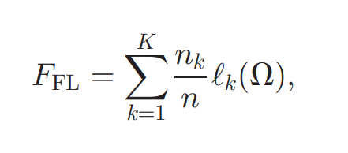
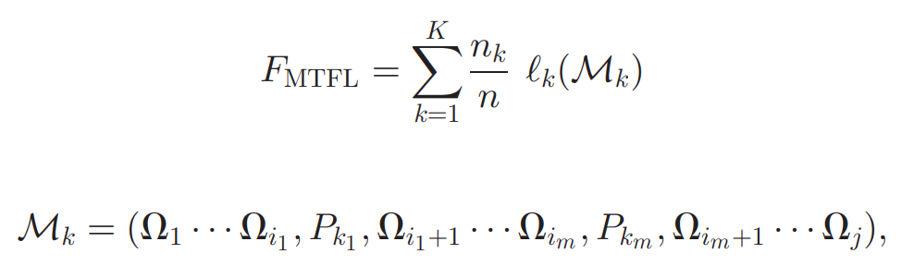
In FL, the aim is to minimize the following objective function
Adding unique client patches to the FL model changes the objective function of MTFL to

Slide 17
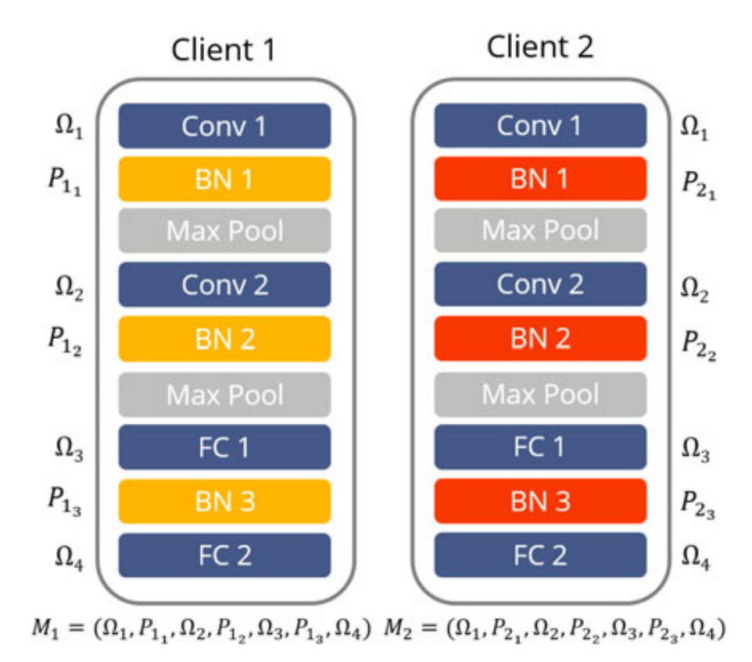

Slide 18
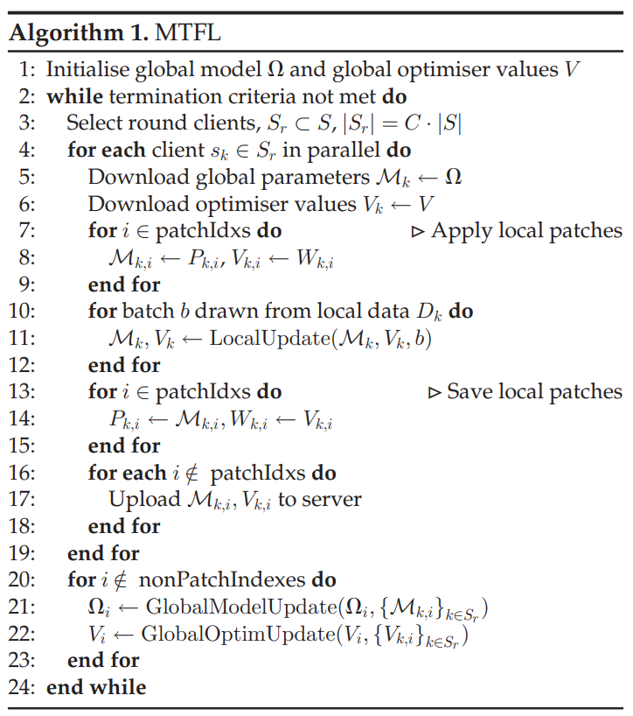

Slide 19
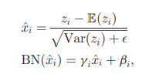
Batch Normalisation (BN) layers can act as model patches for MTL
BN layers are given by
where E(zi) and Var(zi) are the mean and variance of a neuron’s activations across a minibatch, and beta and gamma are parameters learned during training

Slide 20
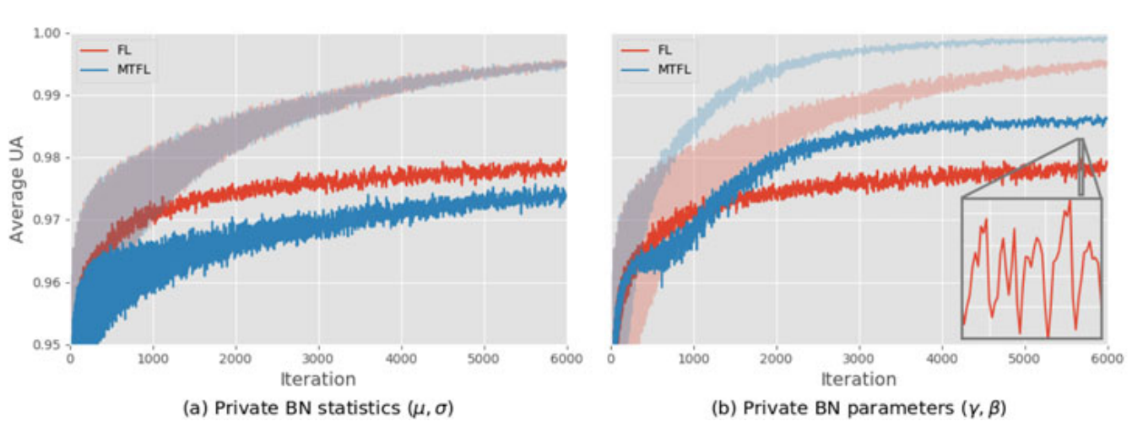

Slide 21
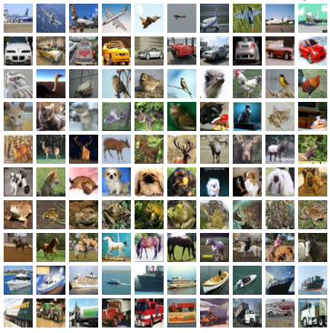
Details of Data sets:
We conduct experiments using two image-classification datasets: MNIST and CIFAR10 , and two DNN architectures.
CIFAR-10 : is a popular image classification dataset that consists of 60,000 images in 10 classes, with 6,000 images per class.

Slide 22
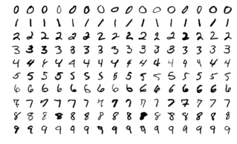
MNIST : is a popular dataset in the field of machine learning .It consists of a set of 70,000 handwritten digit images, with 60,000 images for training and 10,000 images for testing.

Slide 23
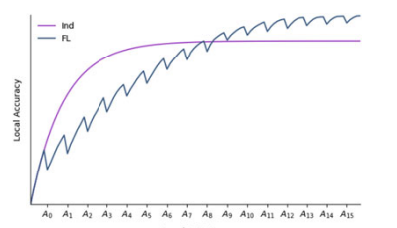
Results Obtained :
Problem after aggregation by using traditional technique

Slide 24
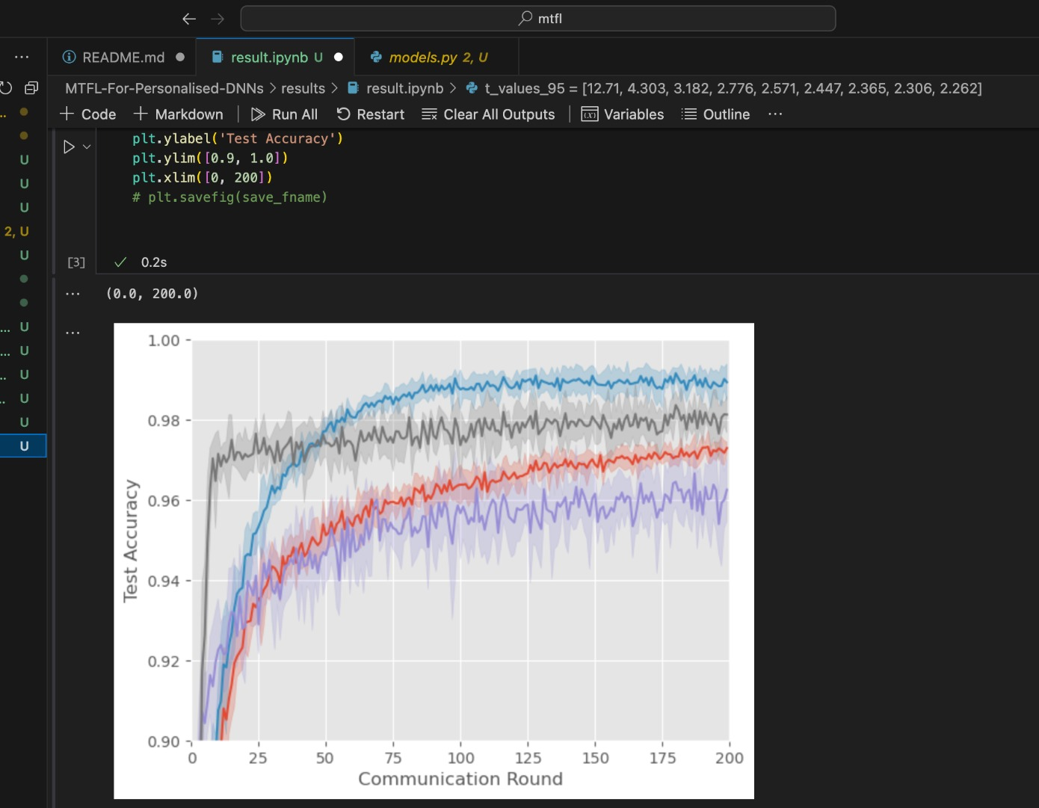

Slide 25
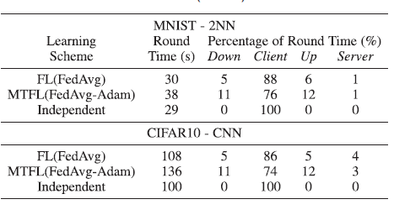
Analysis of result :
Results - Table shows the average time taken per round for FL(FedAvg), MTFL (FedAvg-Adam), and Independent learning, when one local epoch of training is performed.

Slide 26
As would be expected, Independent learning took the least time per round as clients did not have to download / upload any models
FL(FedAvg) took longer per round due to uploading / downloading, and MTFL(FedAvg-Adam) took the longest per round due to the increased number of weights that FedAvg-Adam communicates over FedAvg, indicated by the higher percentage of round time spent downloading and uploading models
The majority of the round times were spent in local training rather than in communication for FL or MTFL
This is due to the low computing power and the high computational cost of training DNN models In real-world FL scenarios, the round times are influenced by the compute abilities of client devices.

Slide 27
Conclusion :
BN layers allow users to have personalized models and significantly improves average User model Accuracy
Experiments using MNIST and CIFAR10 show that MTFL with FedAvg significantly reduces the number of rounds to reach a target average UA compared to FL, by up to 5 times .
Further experiments show that MTFL with FedAvg-Adam reduces this number even further, by up to 3 times .

Slide 28
These experiments also indicate that using private BN trainable parameters (g; b) instead of statistics (m; s) in model patches gives better convergence speed.
Comparison to other state-of-the-art personalized FL algorithms show that MTFL is able to achieve the highest average UA given limited communication rounds.

Slide 29
Future work :
The positive results we obtained justify further investigation of this approach.
In the current investigation we consider image classification as our concern . This work can be extended to other type of classification other than the image classification

Slide 30
